Slide 1
CASA0005: Geographic Information Systems and Science
Dr Andy MacLachlan, Dr Claire Dooley and Dr Ruth Neville
Cecilia Liu, Deng Hong, Huixin Liu, Jishan Duan, Xiang Fang
Centre for Advanced Spatial Analysis

Slide 2
Welcome!!

Slide 3


Housekeeping…
Please ask questions on slack in the #casa0005-gis channel.
Everyone can see slack questions after the session and add responses / further questions and discussion

Slide 4
Expectations…
The teaching team expects:
You to engage with the lectures, workshops and other students
Challenge yourself
Ask questions
Complete the tasks we give you
Listen to our feedback
Understand that we know a lot (?) but not everything…but we will likely know where to look

Slide 5
Expectations…
The students can expect:
Staff to be present and available for questions at the sessions
To be taught current and modern geospatial methodologies and approaches applicable to MSc level of study
To have opportunity to go beyond the core materials
To be challenged

Slide 6
You said … we did…
Summary of responses from surveys:
It’s hard to learn R
More code or workshop explanations / walk throughs
Opportunities to test your knowledge
Practical class are pretty hard to keep up
More optional practices to understand the GIS conception

Slide 7
Housekeeping…
Sessions:
1hr Lecture/homework – Tuesdays 9-10am
IOE 20 Bedford way W3.01
Required
Practical – Tuesdays 10-11am
IOE 20 Bedford way W3.01
Required
Practical– Tuesdays 11-1pm
IOE 20 Bedford way W3.01
Optional
Drop in – Thursdays 1-3pm
Gordon Square (31-34) & (14) Taviton St Archaeology G6 LT
Quiz
Optional

Slide 8

Housekeeping
No lecture & practical in reading week…
15 Credit module ~ 150 hours of work
Assessment:
Practice exam questions released around reading week (10%) due 24th November 5pm.
Open book exam (90%) on 12th December 2025 9am-3pm
We work on practice questions together after reading week
Homework tasks will help you a lot

Slide 9


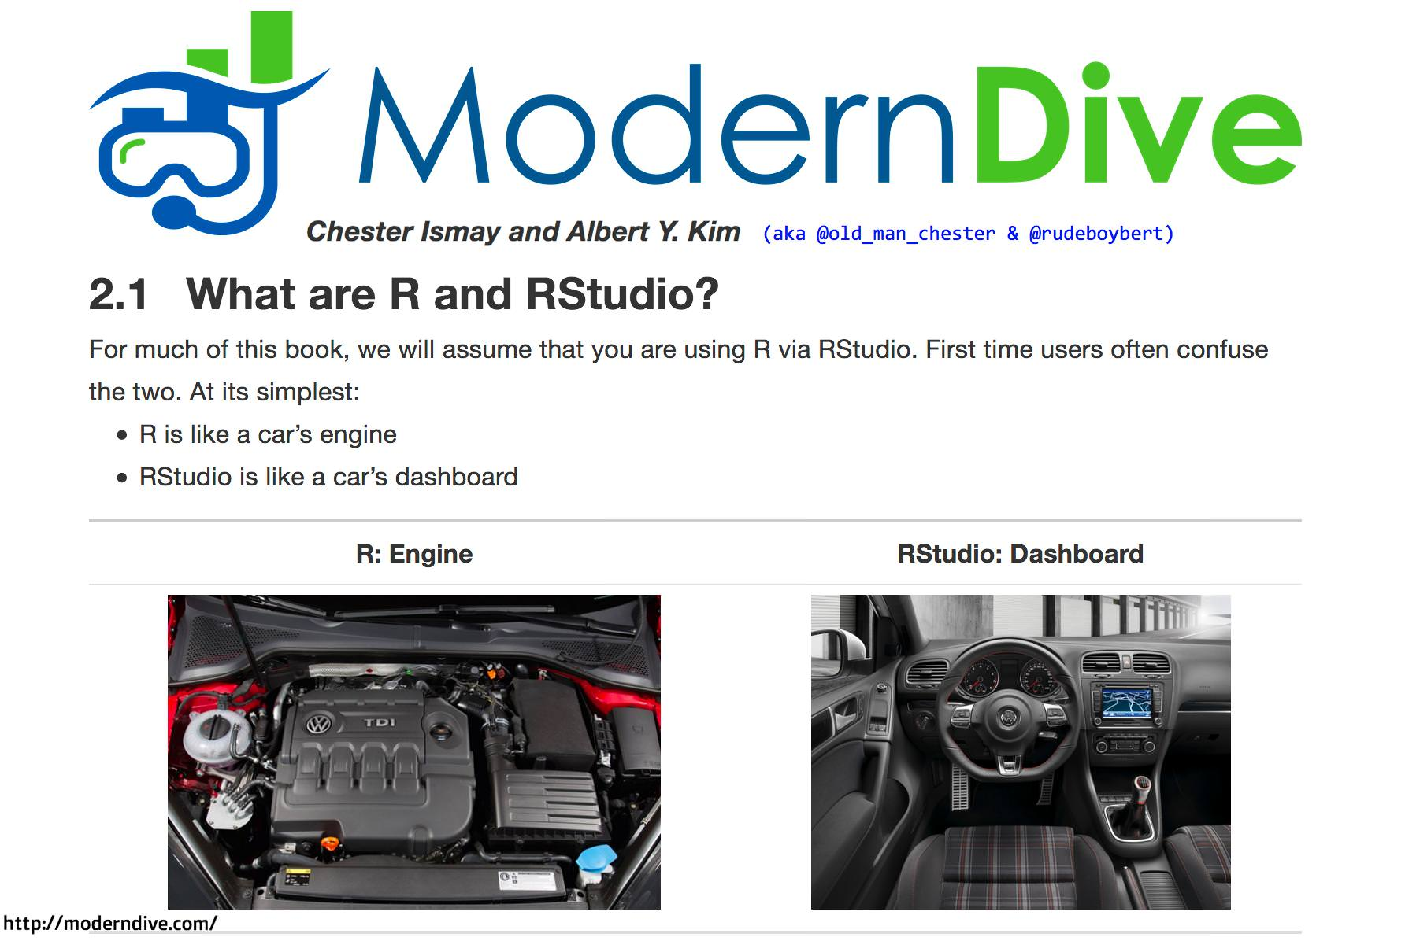
Software for the Course
R (& R Studio)
Available for free from the web
http://www.r-project.org/
http://www.rstudio.com/

Slide 10
Software for the Course
QGIS
Free and Open Source GIS which works on ANY computer operating system with free ‘Plugins’
http://www.qgis.org/

Slide 11
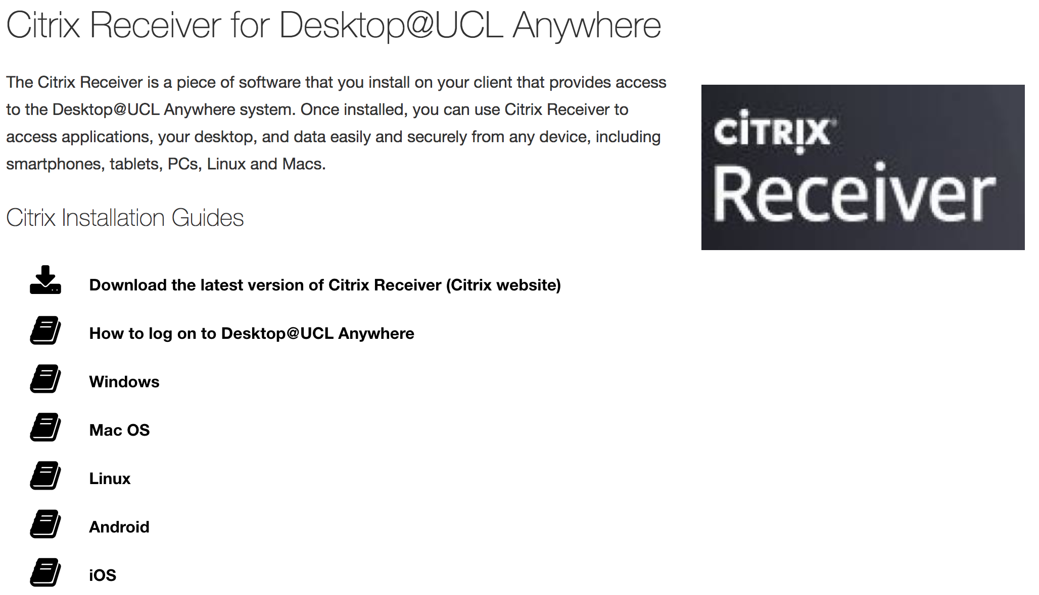
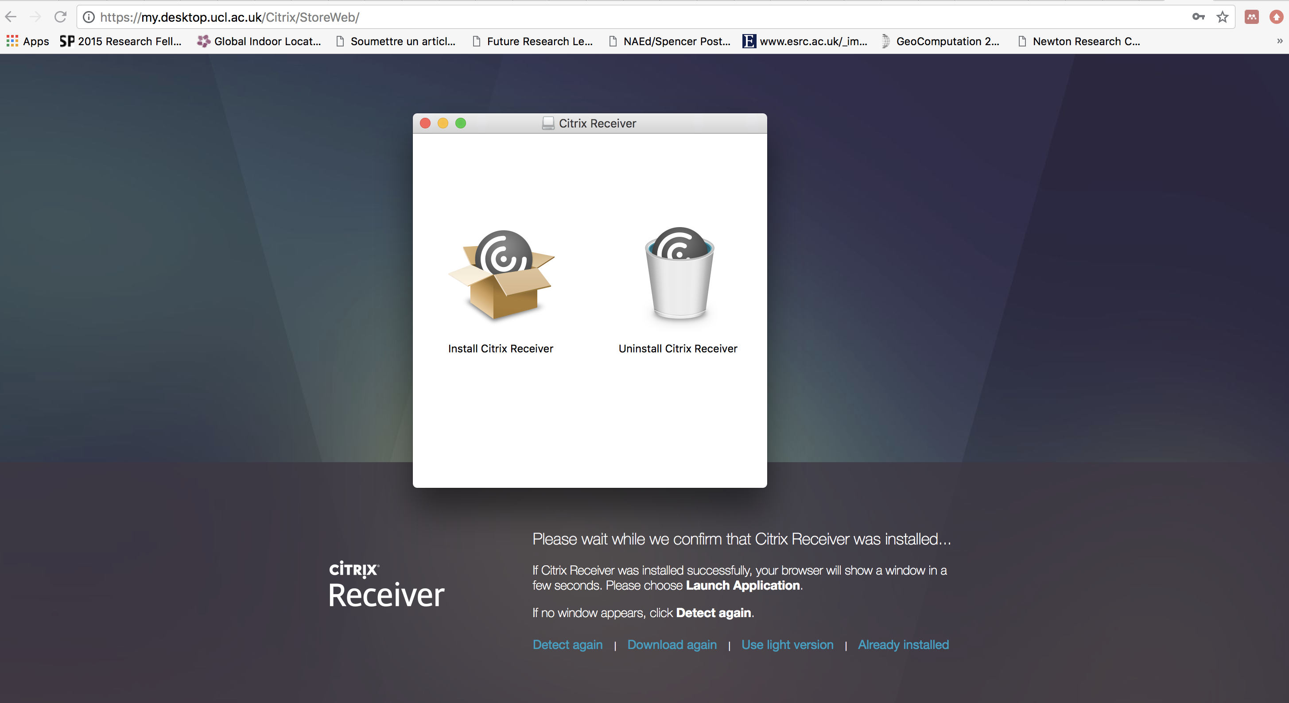

Remote Desktop
For instructions and help:
https://www.ucl.ac.uk/isd/services/computers/remote-access/desktopucl-anywhere/desktopucl-anywhere-how-to-guides

Slide 12
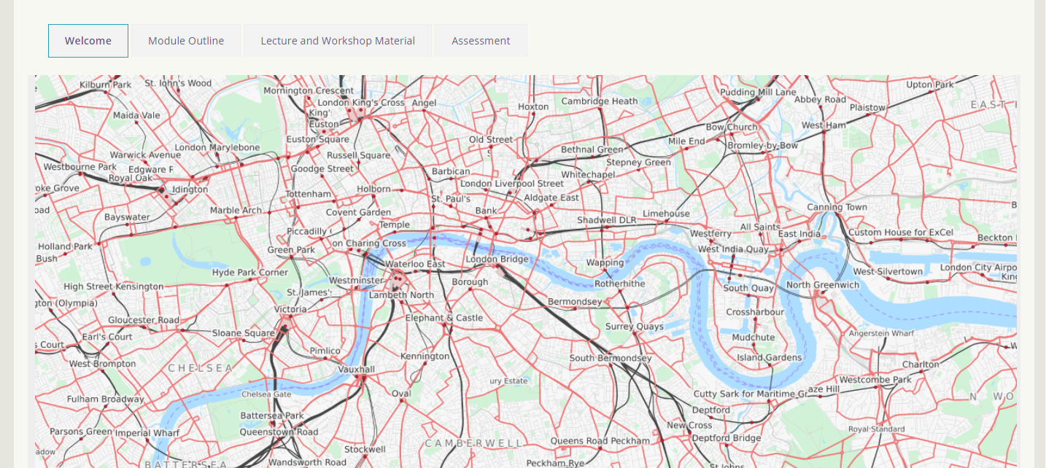
Moodle

Slide 13
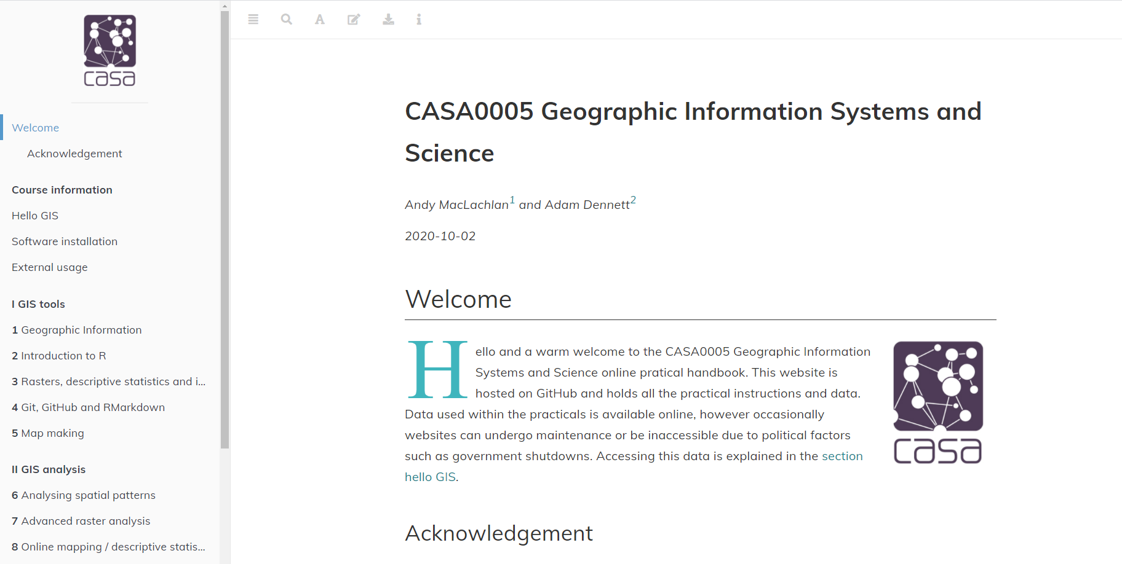
Practical Book run through
Practical book: https://andrewmaclachlan.github.io/CASA0005repo/
Code that ‘powers’ it: https://github.com/andrewmaclachlan/CASA0005repo

Slide 14

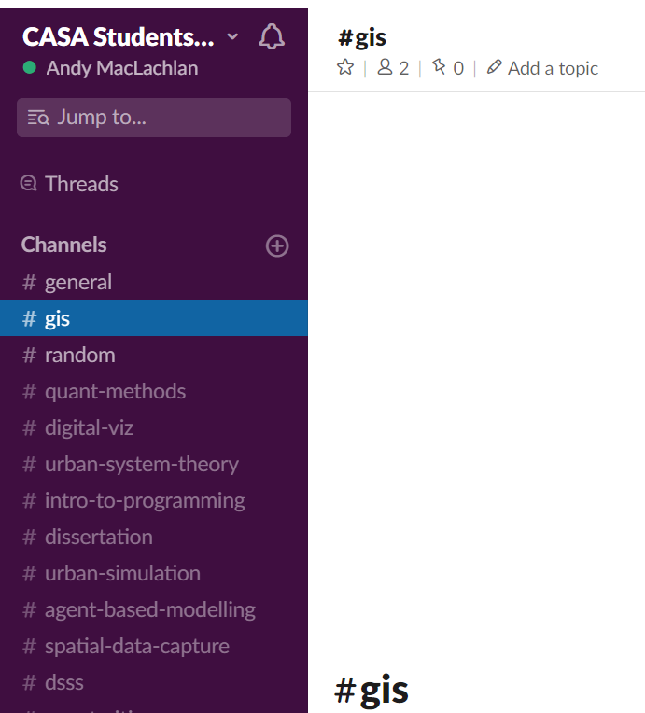
Help and Communication
Sign up via the link on Moodle (all UCL email addresses should be valid)
Any questions, problems, issues etc. post on here

Slide 15


Communication
= Questions that you want answered by the teaching team for the module or questions that you want to discuss with each other knowing the staff can help #GIS channel. Access the link on Moodle
= Personal / administration issues only. If you ask a question about module or assignment content expect “please ask this question on slack” between 1 and 5 days later.

Slide 16
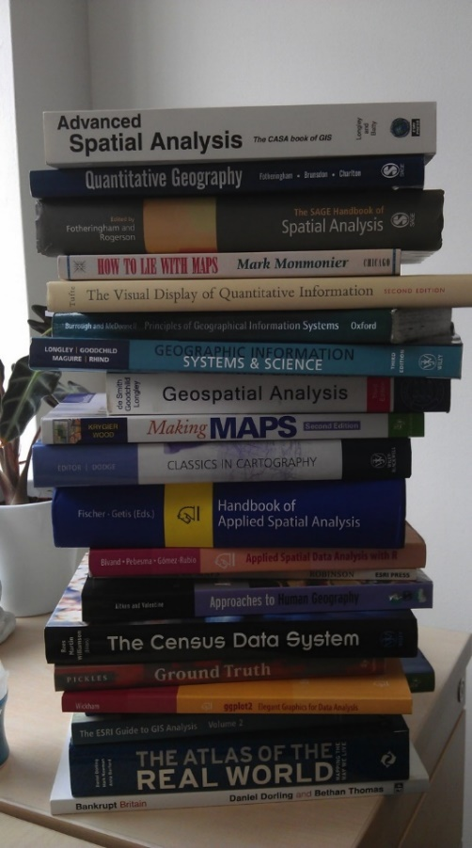
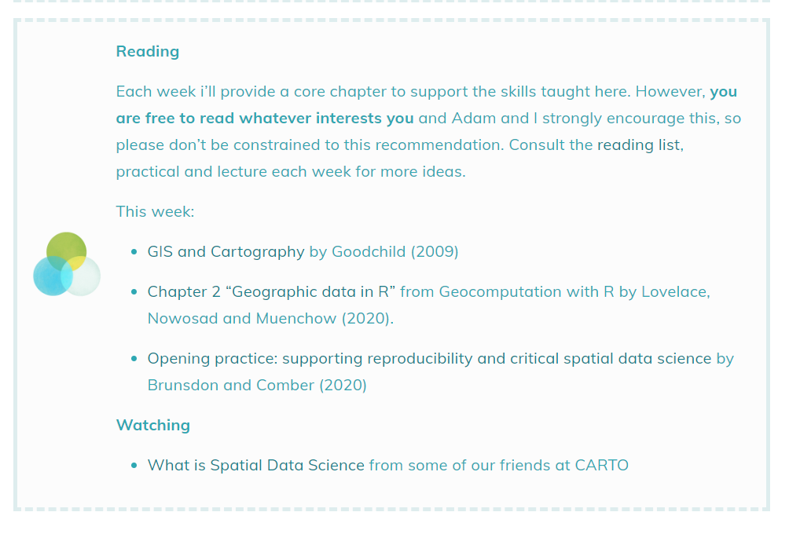
Reading List
Links in the practical book
Reading for each week

Slide 17
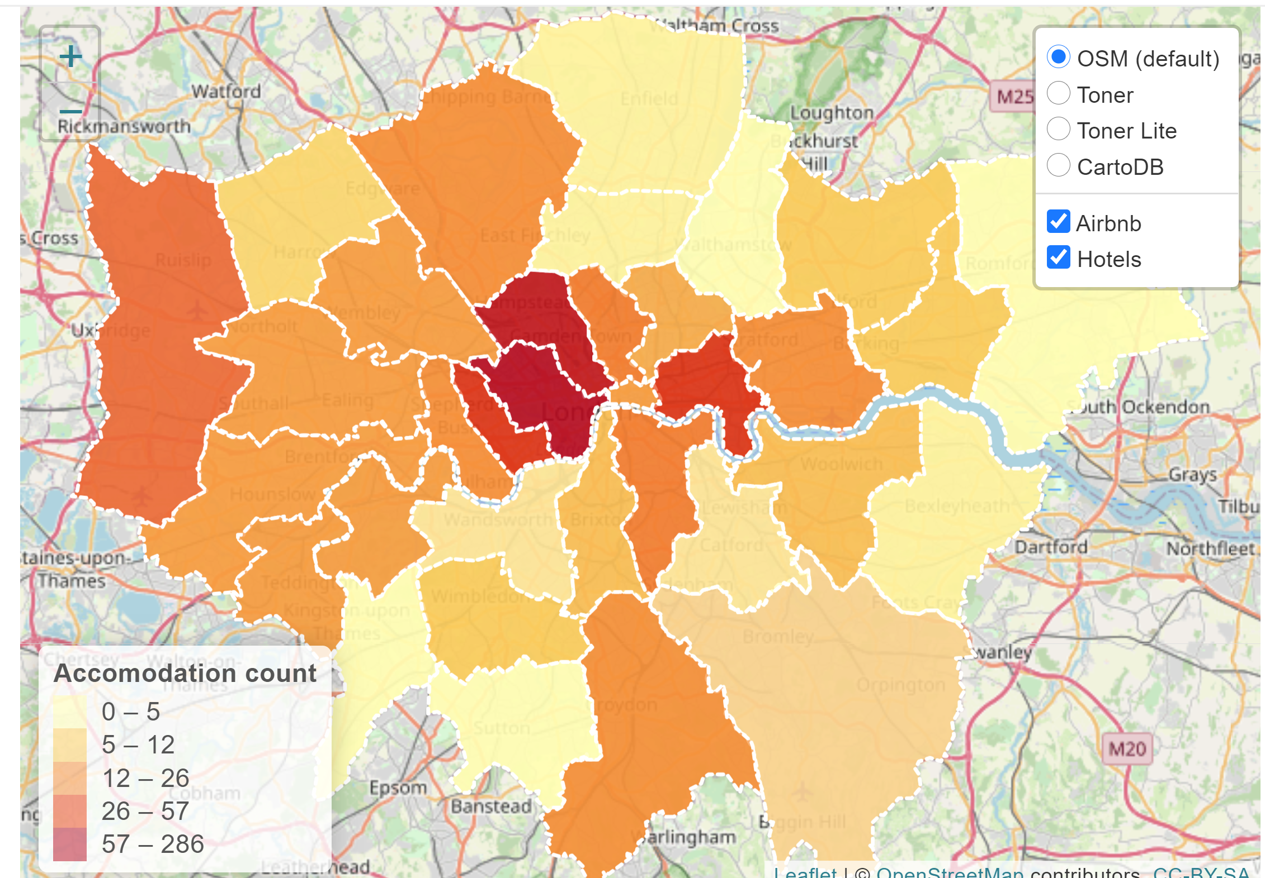
What will I learn in this course?
How to make cool interactive maps / good and bad cartography practices

Slide 18






What will I learn in this course?
All about spatial data…
Where we can get it
How it’s stored, principal formats etc.

Slide 19

What will I learn in this course?
How to be a good Geographic Information / Spatial Data Scientist
By being aware of problems in the definition, measurement and accuracy of spatial data and how these might affect our analyses
By being practiced in the process of converting raw data into information to solve spatial problems…
…through becoming familiar with a variety of spatial analysis techniques and how to apply them…
And by being self-critical throughout

Slide 20


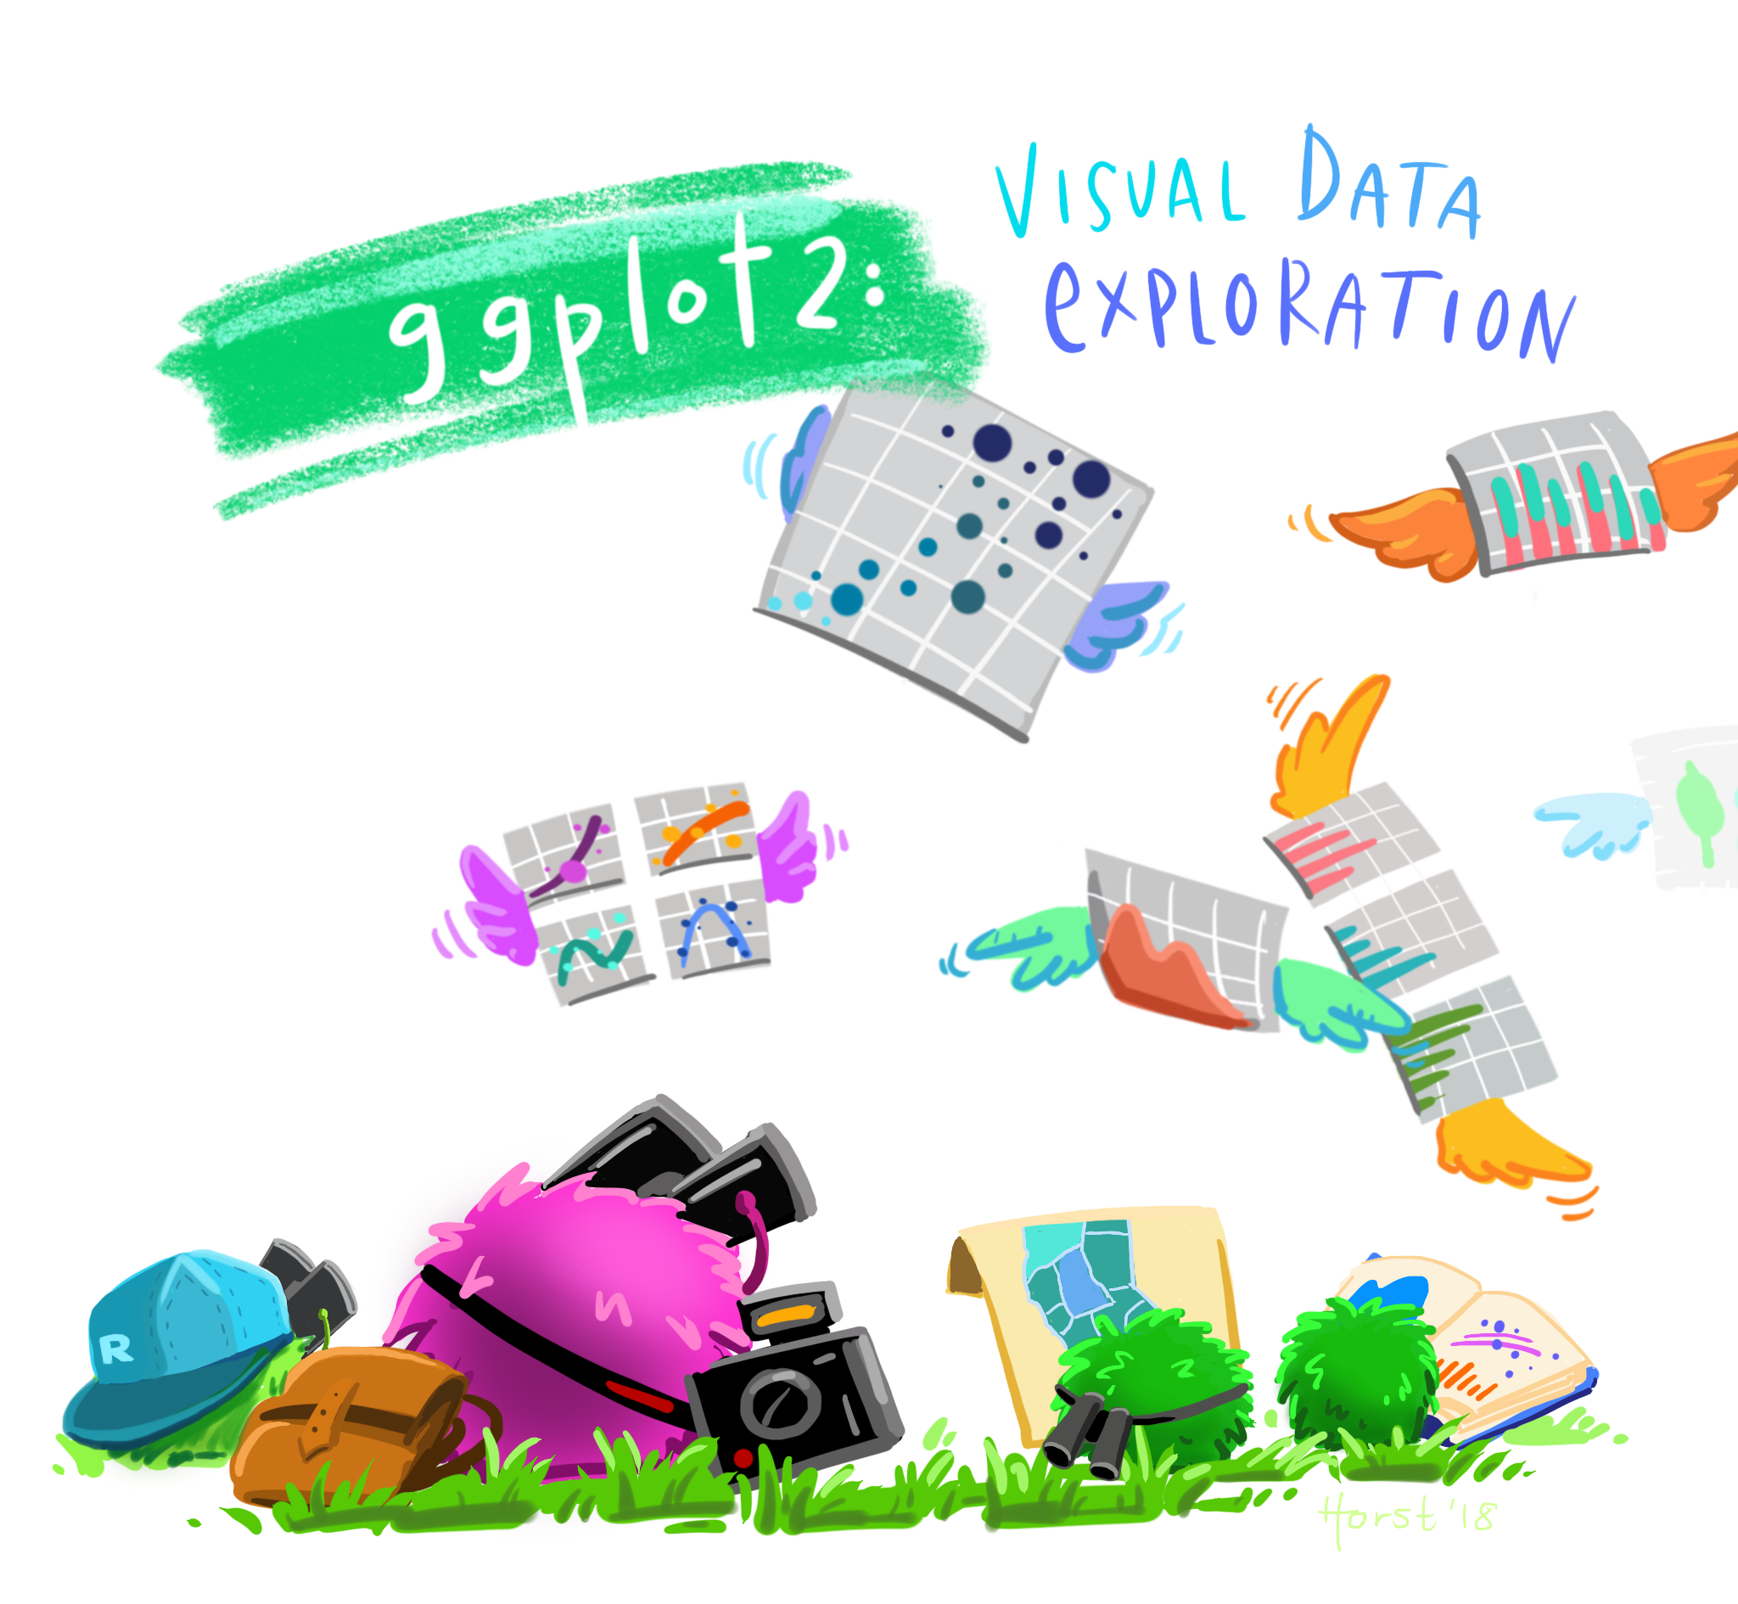

What will I learn in this course?
Practical / transferable skills – how to program in R and use QGIS software. Images from Allison horst
The grammar of:
Graphics
Data manipulation
%>% means then

Slide 21
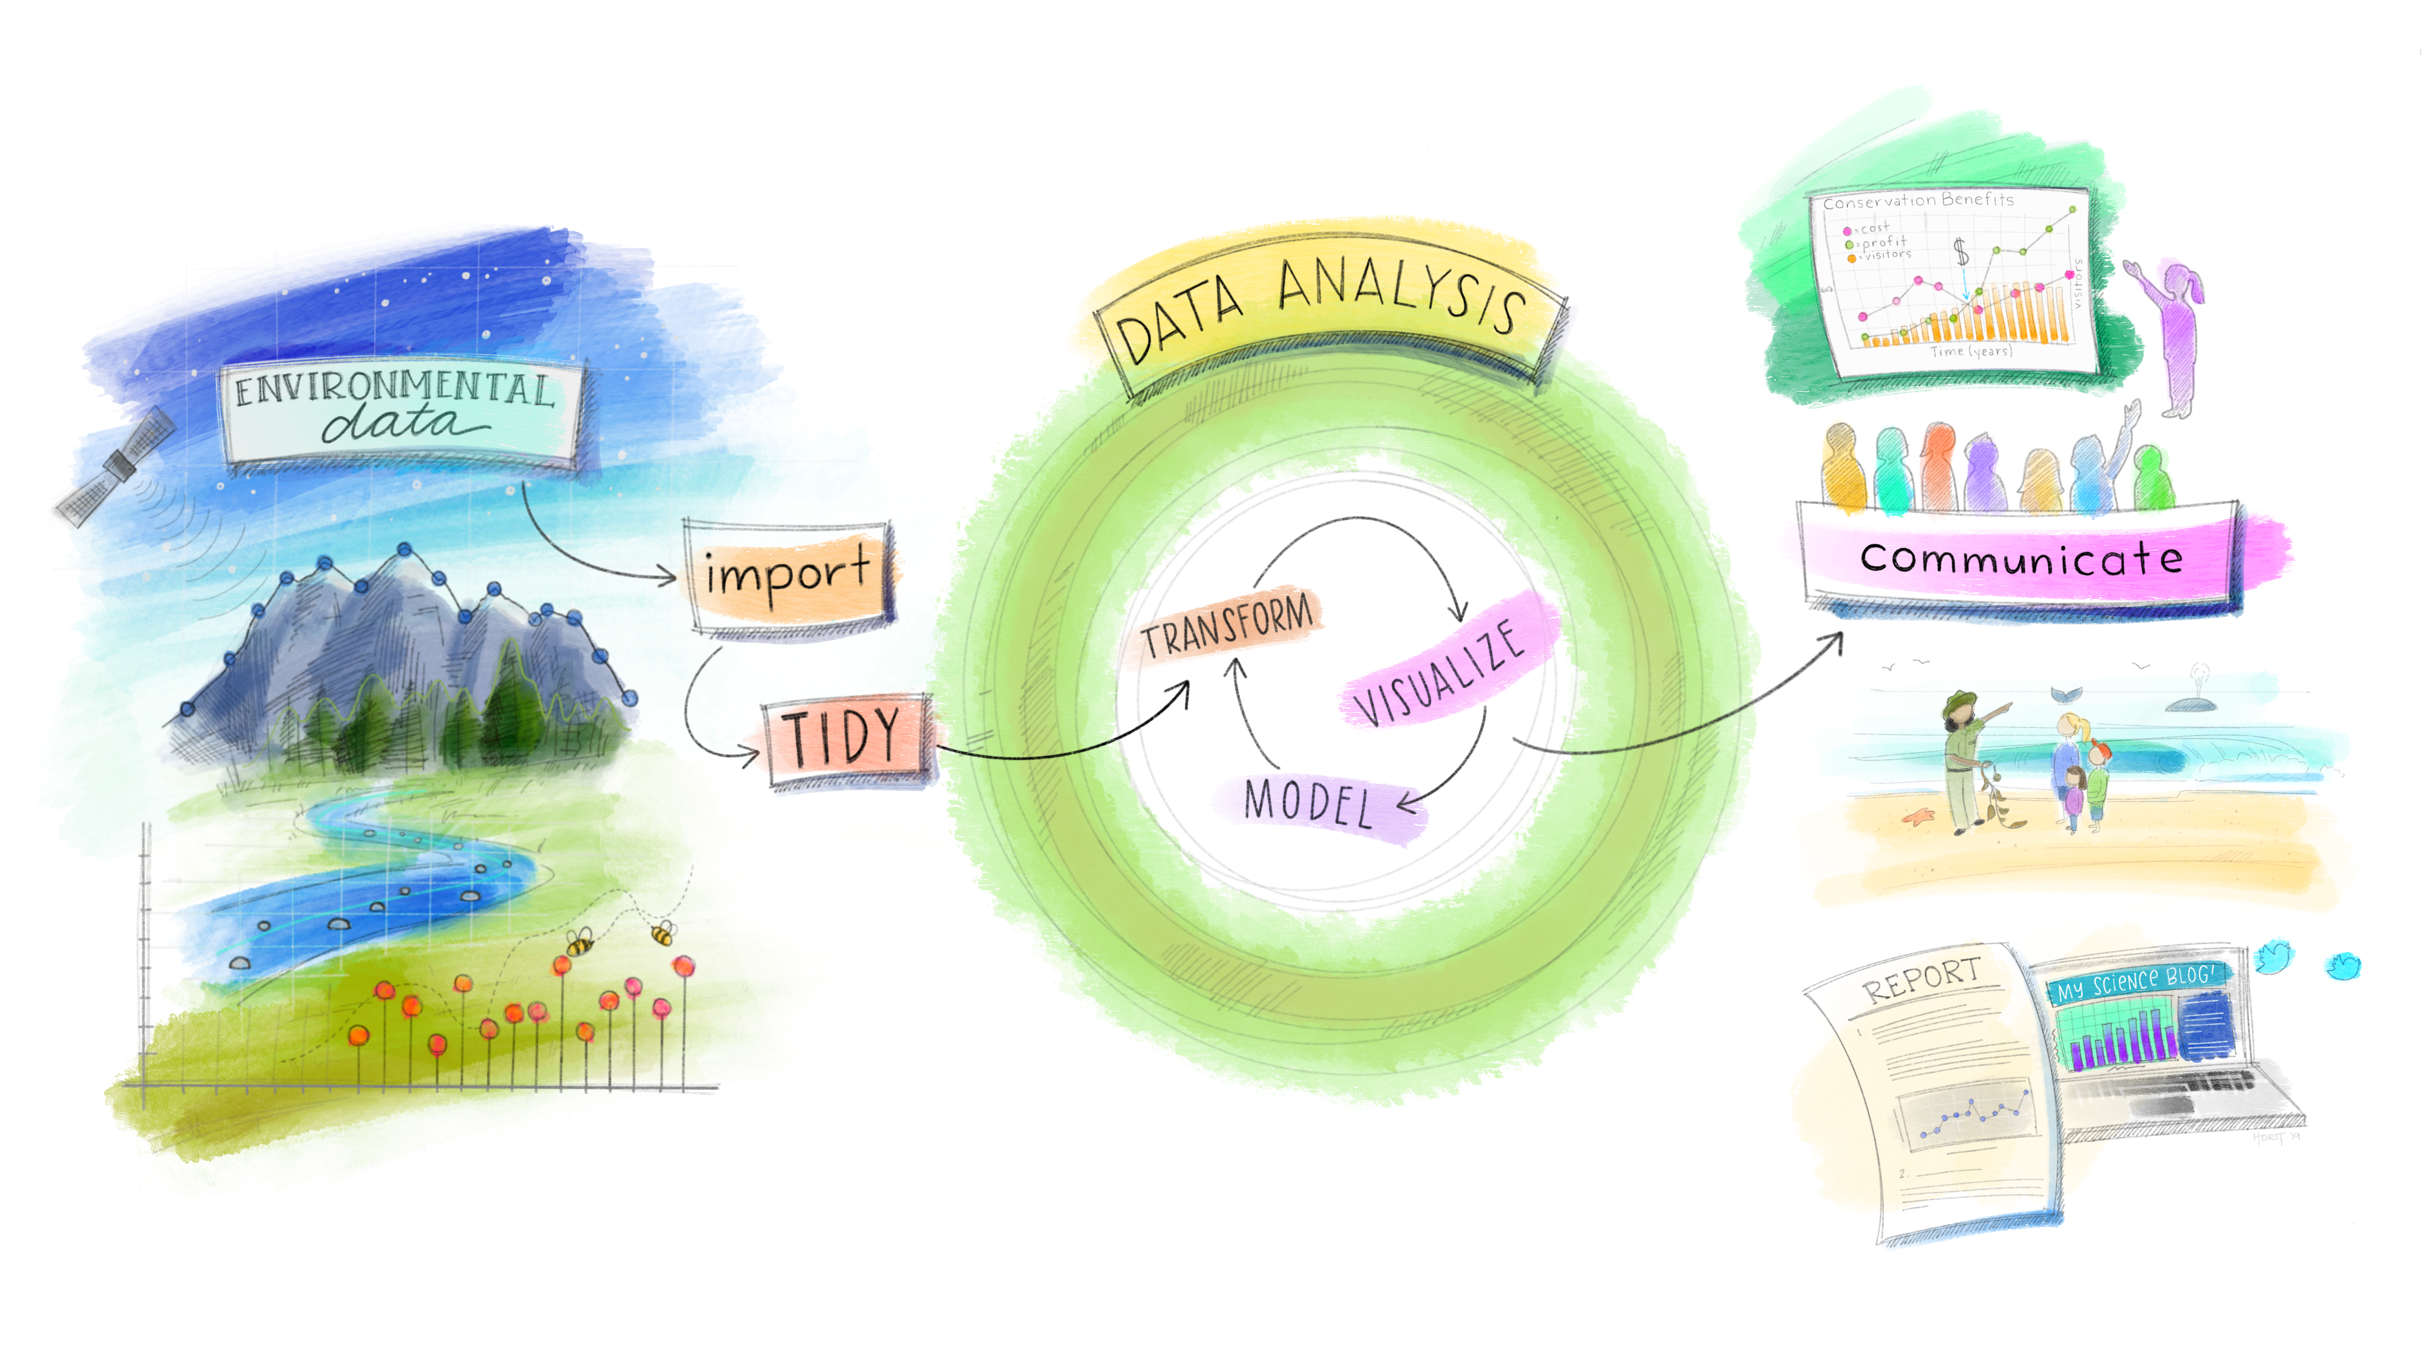
What will I learn in this course?
Practical / transferable skills – how to program in R and use QGIS software. Image from Julia Lowndes adapted from Grolemund and Wickham.

Slide 22
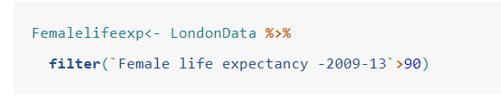
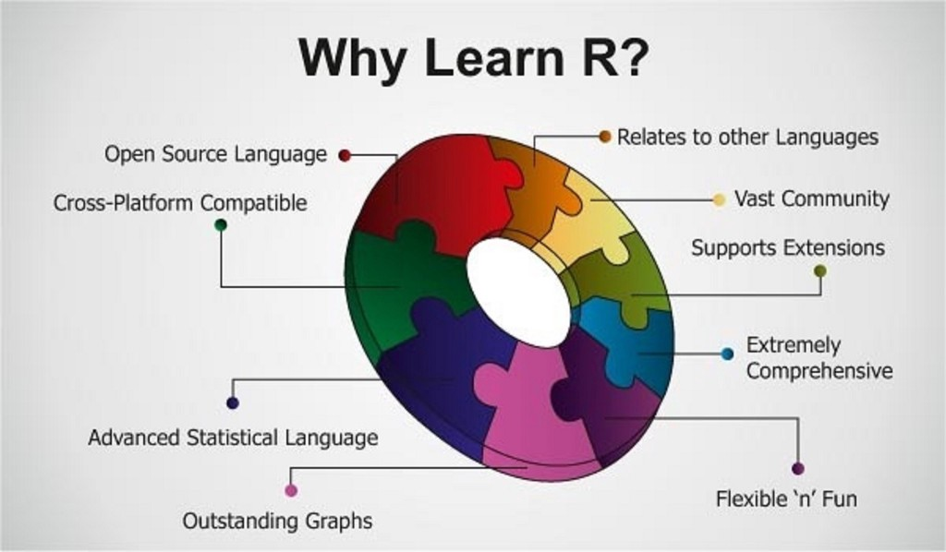
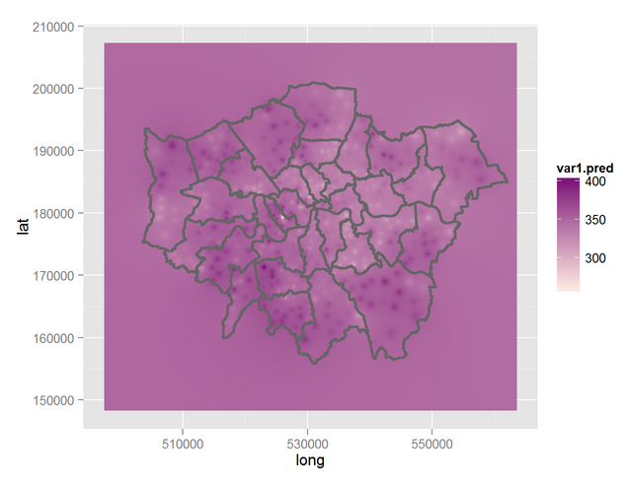
What will I learn in this course?
Practical / transferable skills – how to program in R and use QGIS software

Slide 23


What will I learn in this course?
Practical / transferable skills – how to program in R and use QGIS software
Can you do this in excel?

Slide 24

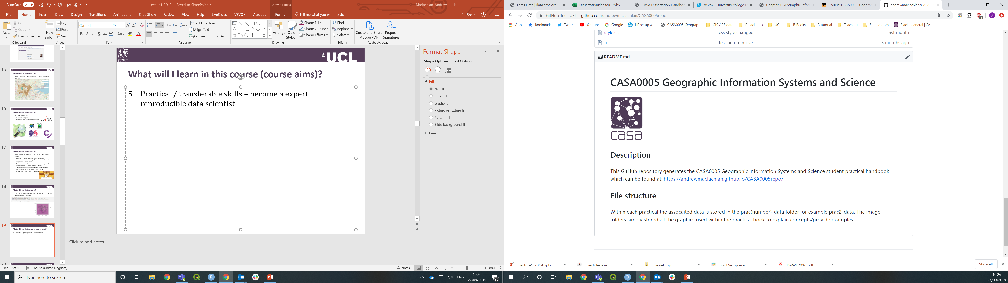
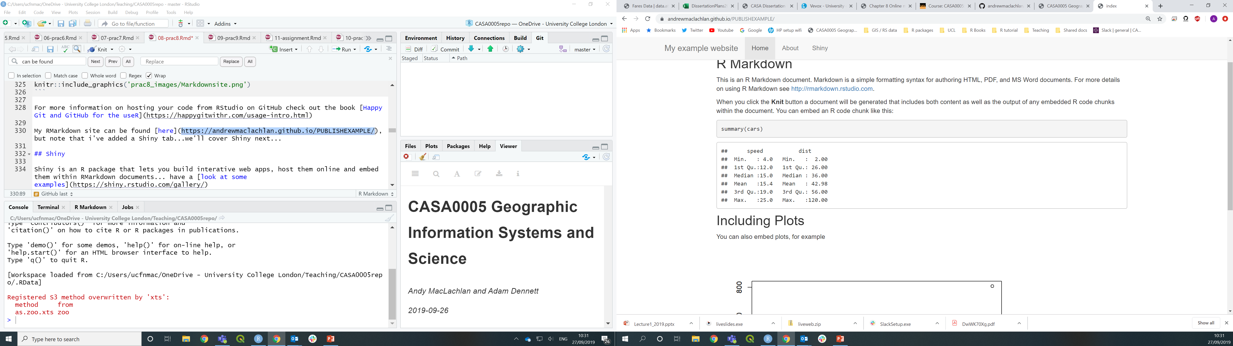
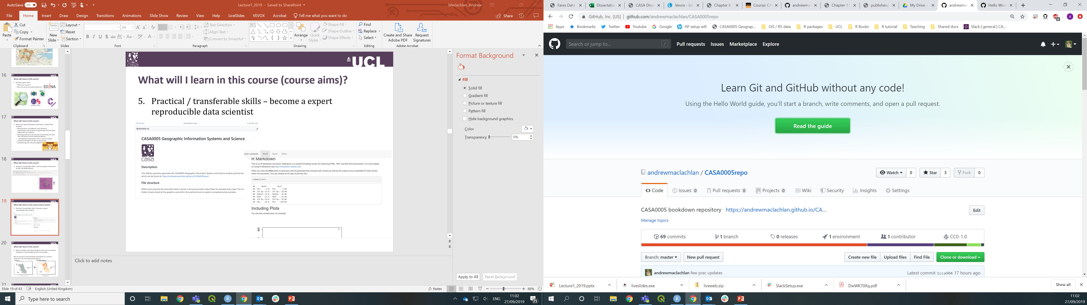
What will I learn in this course?
Practical / transferable skills – become a expert reproducible data scientist

Slide 25
What will I learn in this course?
How to combine all of these things to solve a spatial problem in a reproducible manner…
“The UK Government want to ensure as many people are vaccinated for COVID-19 as possible. You have been tasked as a consultant to investigate what spatial factors might influence low vaccine uptake in London in particular”
COVID 19 **weekly announced vaccinations**. Note that the last data to include **MSOA** was the COVID-19 weekly announced vaccinations 15 September 2022. After this date there was a change in output that excluded MSOA: https://www.england.nhs.uk/statistics/statistical-work-areas/covid-19-vaccinations/
London MSOA shapefile: shapefile: https://data.london.gov.uk/dataset/statistical-gis-boundary-files-london
London Atlas: https://data.london.gov.uk/dataset/msoa-atlas

Slide 26
What won’t I learn on this course…?
GIS is a huge field and so we can’t possibly cover everything in 10 weeks.
Many of the examples will be related to spatial demographics (using Census data) and we be will be UK (especially London).

Slide 27
Course content:
The course is divided into two ‘main’ parts.
Before reading week we cover all the software are tools you’ll need. Part 1 GIS tools.
The second part changes to advanced analysis – the type in the exam. Part 2 GIS analysis.
Full course outline is available over on Moodle along with the intended learning outcomes for the module
Each workshop also has associated learning outcomes.

Slide 28
Module learning outcomes (on Moodle):
Develop a working knowledge of QGIS and R to support the application of GI Science techniques
Visualise geographic information through producing appropriate maps to high cartographic standards
Carry out spatial data management tasks (joining attribute to geometry data, cleaning data, converting between file formats and spatial reference systems)
Interpret data and apply relevant spatial analyses (e.g. auto correlation/hot spot analysis, areal interpolation, point in polygon/buffer analysis) to answer a variety of spatial problems
Explain and evaluate common issues with geographic data such as representation and uncertainty
Apply and critique (spatial) statistical analysis techniques to infer relationships between spatial phenomena
Experience the diversity of the global spatial data landscape and evaluate the relative drawbacks and merits of different spatial datasets

Slide 29
Preparing for the assessment
This year the assessment is an open book exam:
Don’t just mindlessly do the practical each week
The weekly tasks are there to test you understand what you’ve done
Do the weekly homework tasks
The exam will be much easier as you’ll have a bank of code to use / know what to do.

Slide 30

General Advice for the Course
Be patient!!
Things will crash
You will get lost/stuck and need to start again
R will send you crazy at times
I will be assessing your ability to solve problems / answer questions using spatial data and the application of appropriate GIS tools
Put in the appropriate number of hours and you will be fine
Relax - we have plenty of time!

Slide 31

You do not need to memorise everything…
Learn the process / workflow / tools, what they can do and where they are appropriate.
Search for how to implement them

Slide 32
Right, now for the lecture…

Slide 33
Learning objectives and GIS basics
Describe and explain GIS data formats and databases
Source and pre-process spatial data
Load and undertaken some basic manipulation of spatial data in QGIS and R
Evaluate the (dis)advantages of each GIS you have used
A few terms:
Geographic / geographical: the Earth's surface and near-surface
Spatial: any space, (not just the space of the Earth's surface)
Spatial Analysis: application of techniques (in GIS) to geographic (Earth’s surface) and non-geographic spaces
Geospatial: subset of spatial applied specifically to the Earth's surface and near-surface

Slide 34
Learning objectives and GIS basics
A few terms:
Geographic / geographical: the Earth's surface and near-surface
Spatial: any space, (not just the space of the Earth's surface)
Spatial Analysis: application of techniques (in GIS) to geographic (Earth’s surface) and non-geographic spaces
Geospatial: subset of spatial applied specifically to the Earth's surface and near-surface
Used interchangeably, should we be Urban Geospatial Science.

Slide 35
What have you previously studied?

Slide 36
Have you used GIS software before?

Slide 37
What is data?....
What is spatial data?...
Come and draw some…
* Bus stop
* House
* Road

Slide 38
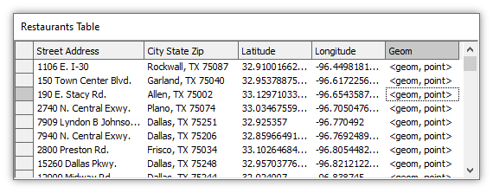
Spatial data
Spatial data = like normal data but has a geometry column or “geom” column.
E.g. a restaurants in a city

Slide 39
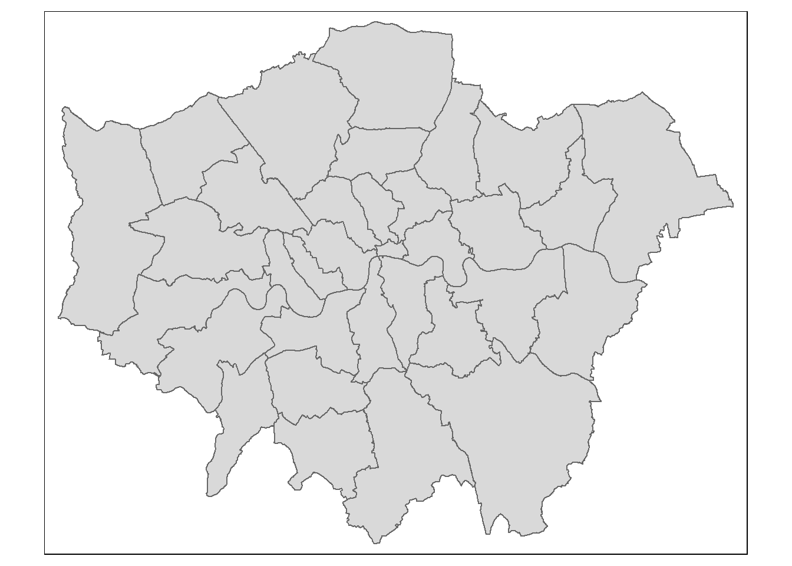
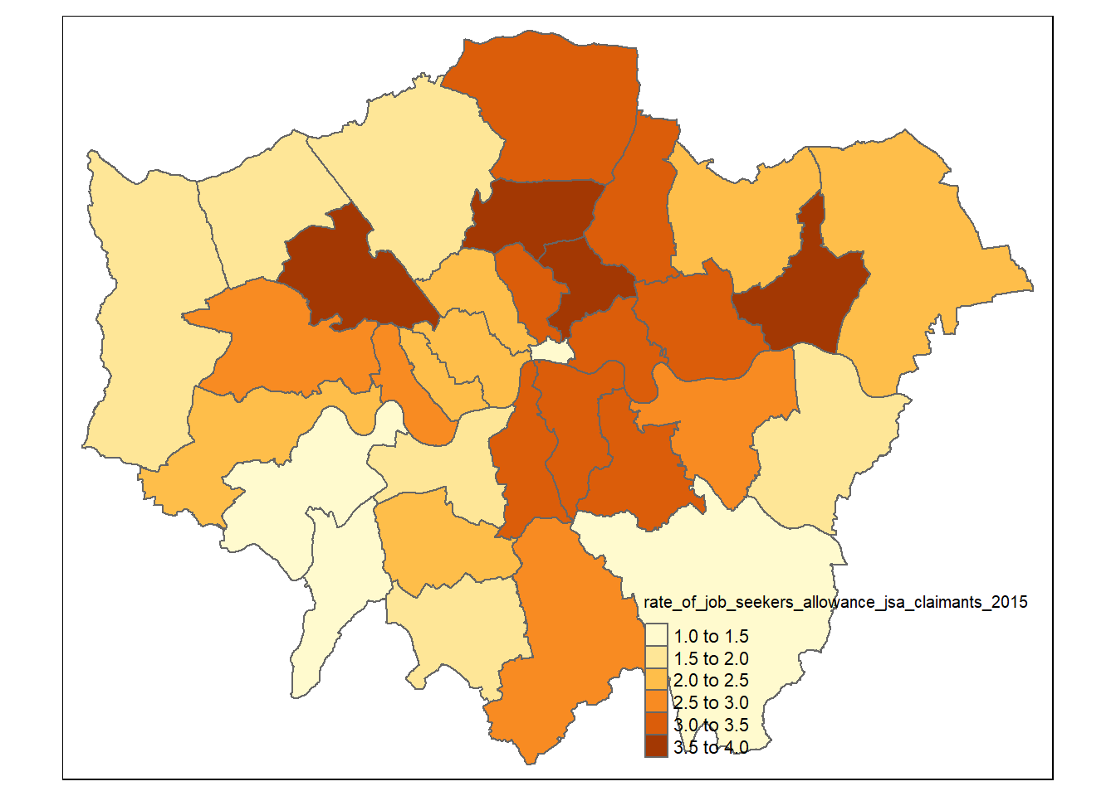
Spatial data
Spatial data is typically an empty shape or object:
Grid cells / hexagons
Polygons
Lines
Points (e.g. restaurants)
The magic happens when we join non spatial data to spatial data

Slide 40
If someone gives you some (spatial) data, what is the first thing you might do…
e.g. here is an excel file that has data on
BMI
steps taken per day
location

Slide 41
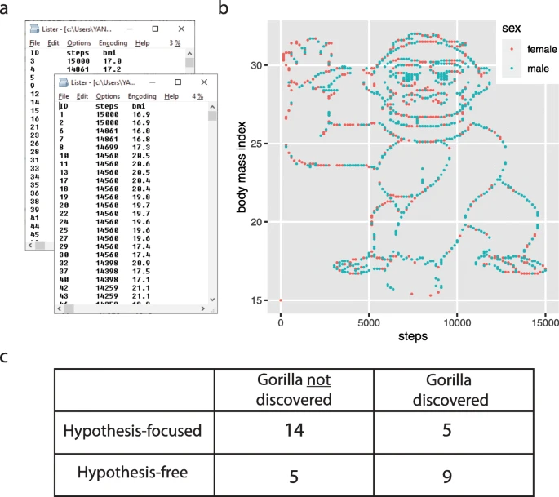
Plot it….or open it
“The most notable “discovery” in the dataset was that if you simply plotted the number of steps versus the BMI, you would see an image of a gorilla waving at you (Fig. 1b). While we teach our students the benefits of visualization, answering the specific hypothesis-driven questions did not require plotting the data. We found that very often, the students driven by specific hypotheses skipped this simple step towards a broader exploration of the data. In fact, overall, students without a specific hypothesis were almost five times more likely to discover the gorilla when analyzing this dataset”
Yanai and Lercher (2020)

Slide 42
How do we analyse spatial data ?

Slide 43
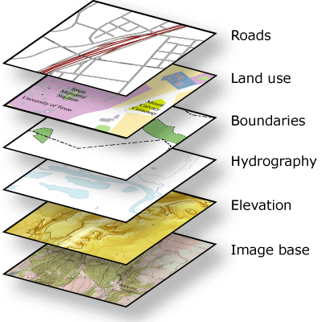





What is GIS?
Geographic Information Systems?
Or
Geographic Information Science?
Or
Spatial Data Science?
Well all of the above really…
…all data is collected
somewhere
Notes:
GI Systems – what and where
GI Science – how, that then informs GI systems
Geographic Information Systems help us to manage “what we know about the world”…
organize and store
access and retrieve
manipulate and synthesize
At their very base they contain Data which are raw geographic facts
e.g. a temperature at a given location on the earth’s surface

Slide 44
What is a GIS?
“Everyone does need to learn to code. It is no longer sufficient for a GI Scientists to just work with a standard GIS interface: menus, buttons and black boxes. ” Brunsdon and Comber (2020)
Previous work
Comparison of 4 GWR approaches all produced the same result except the method in ArcGIS from ESRI who didn’t reveal the code.

Slide 45
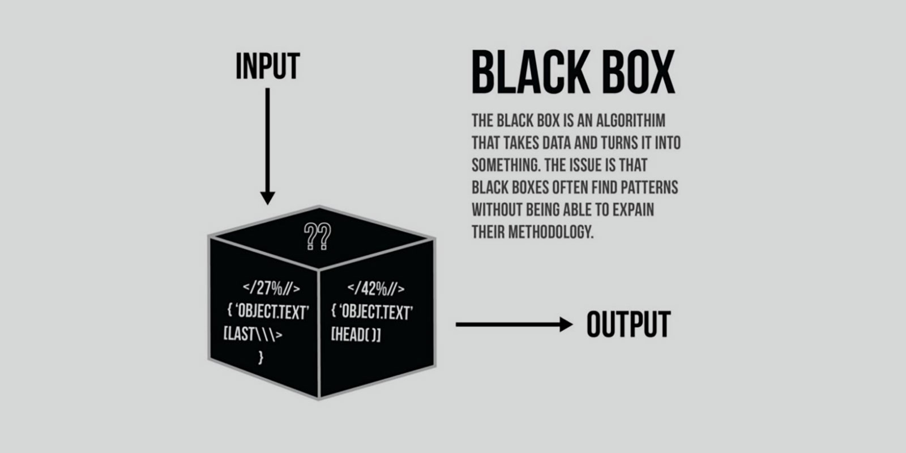
What is a black box?

Slide 46


Slide 47
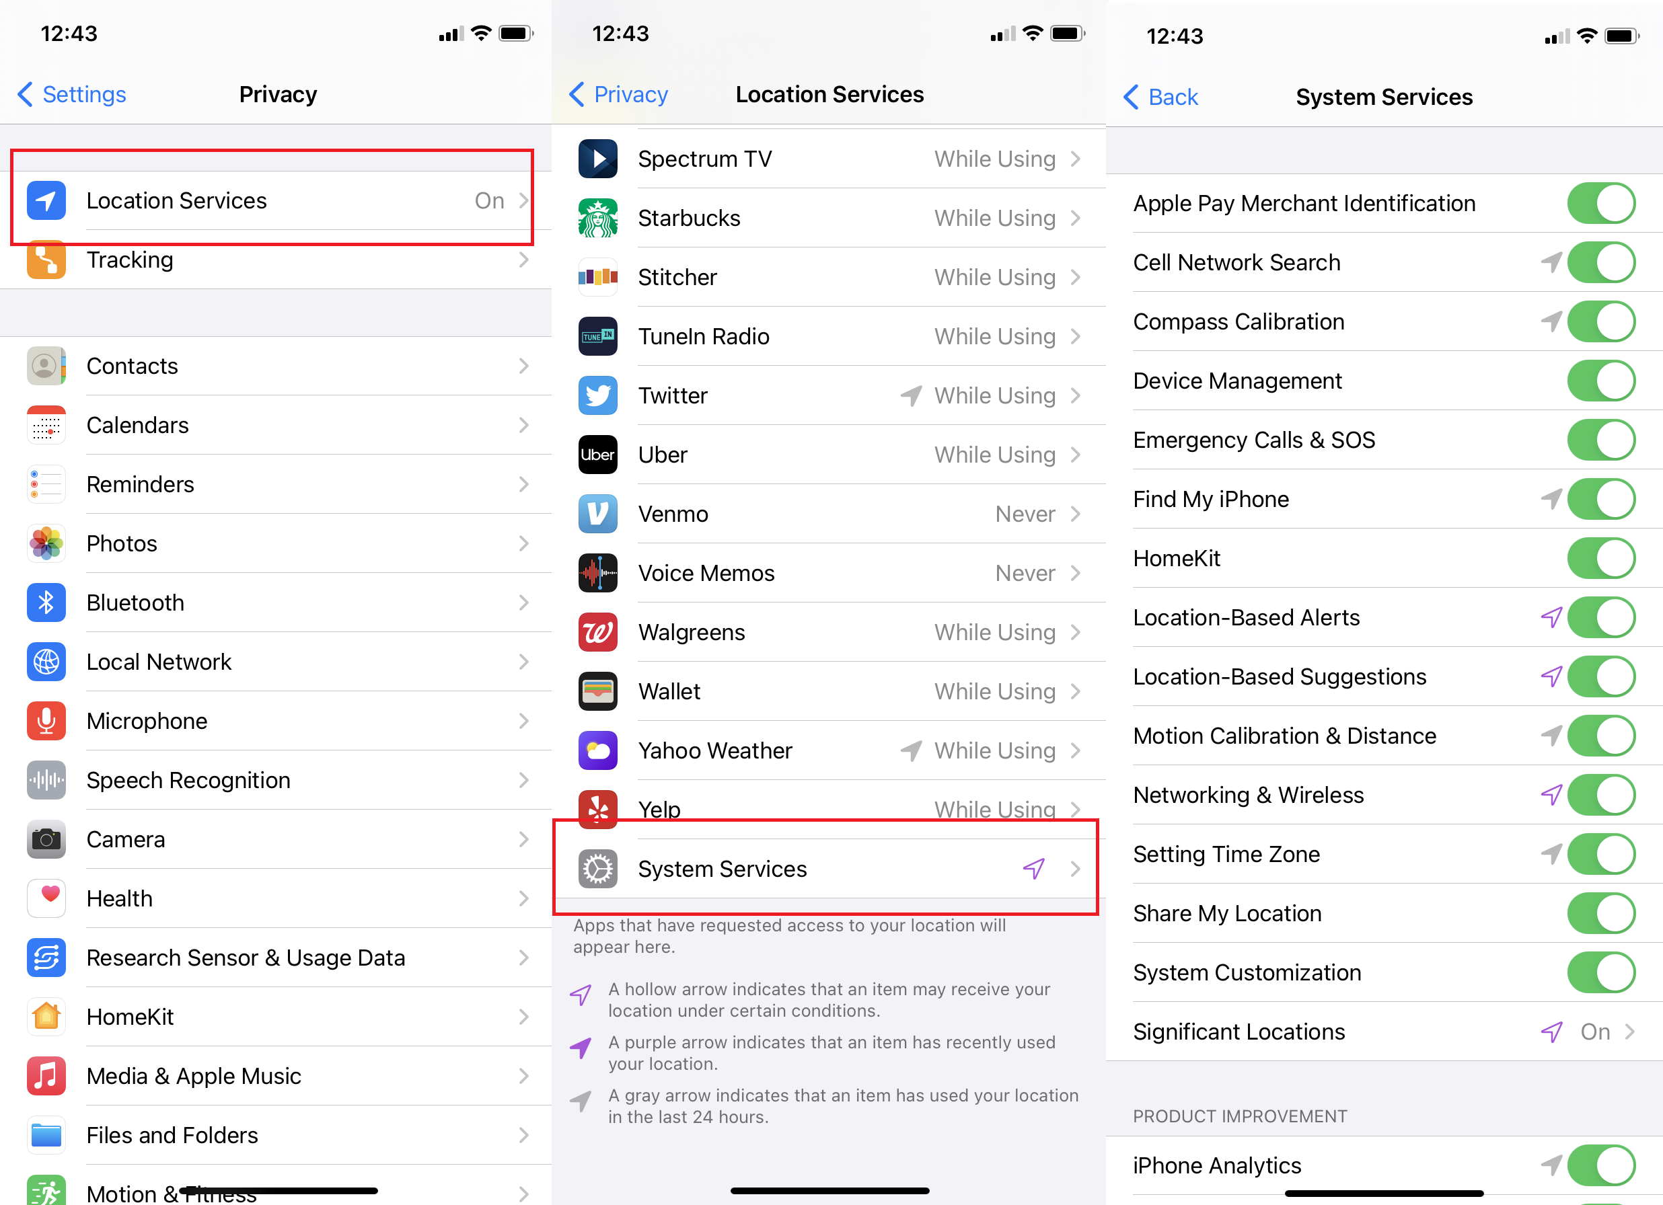

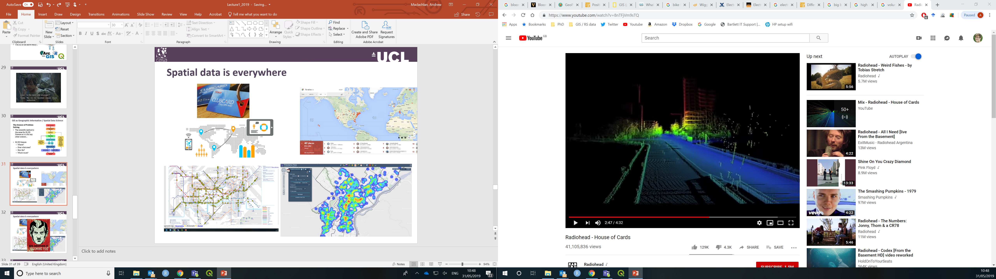
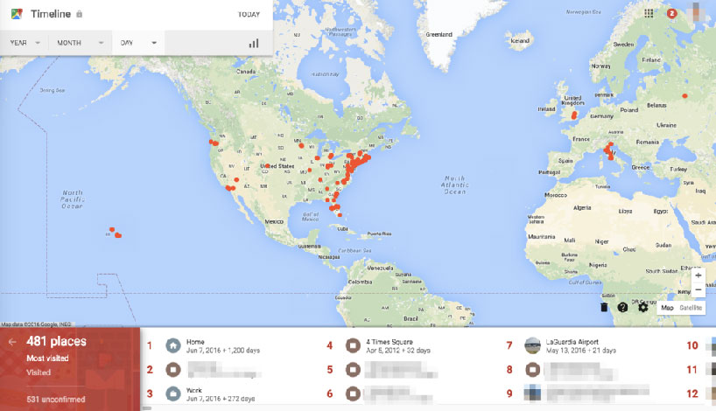

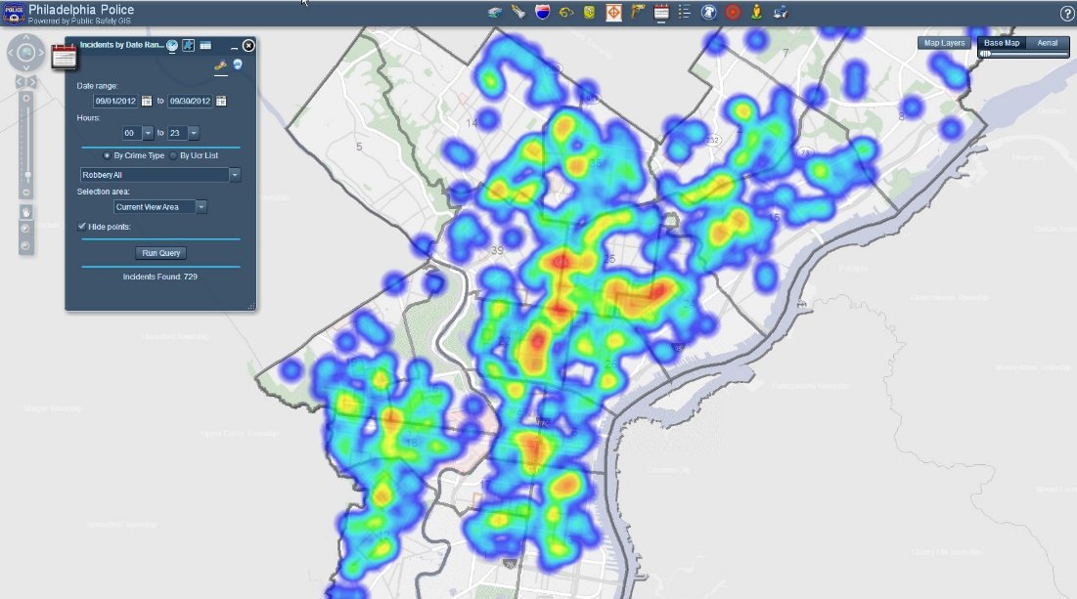
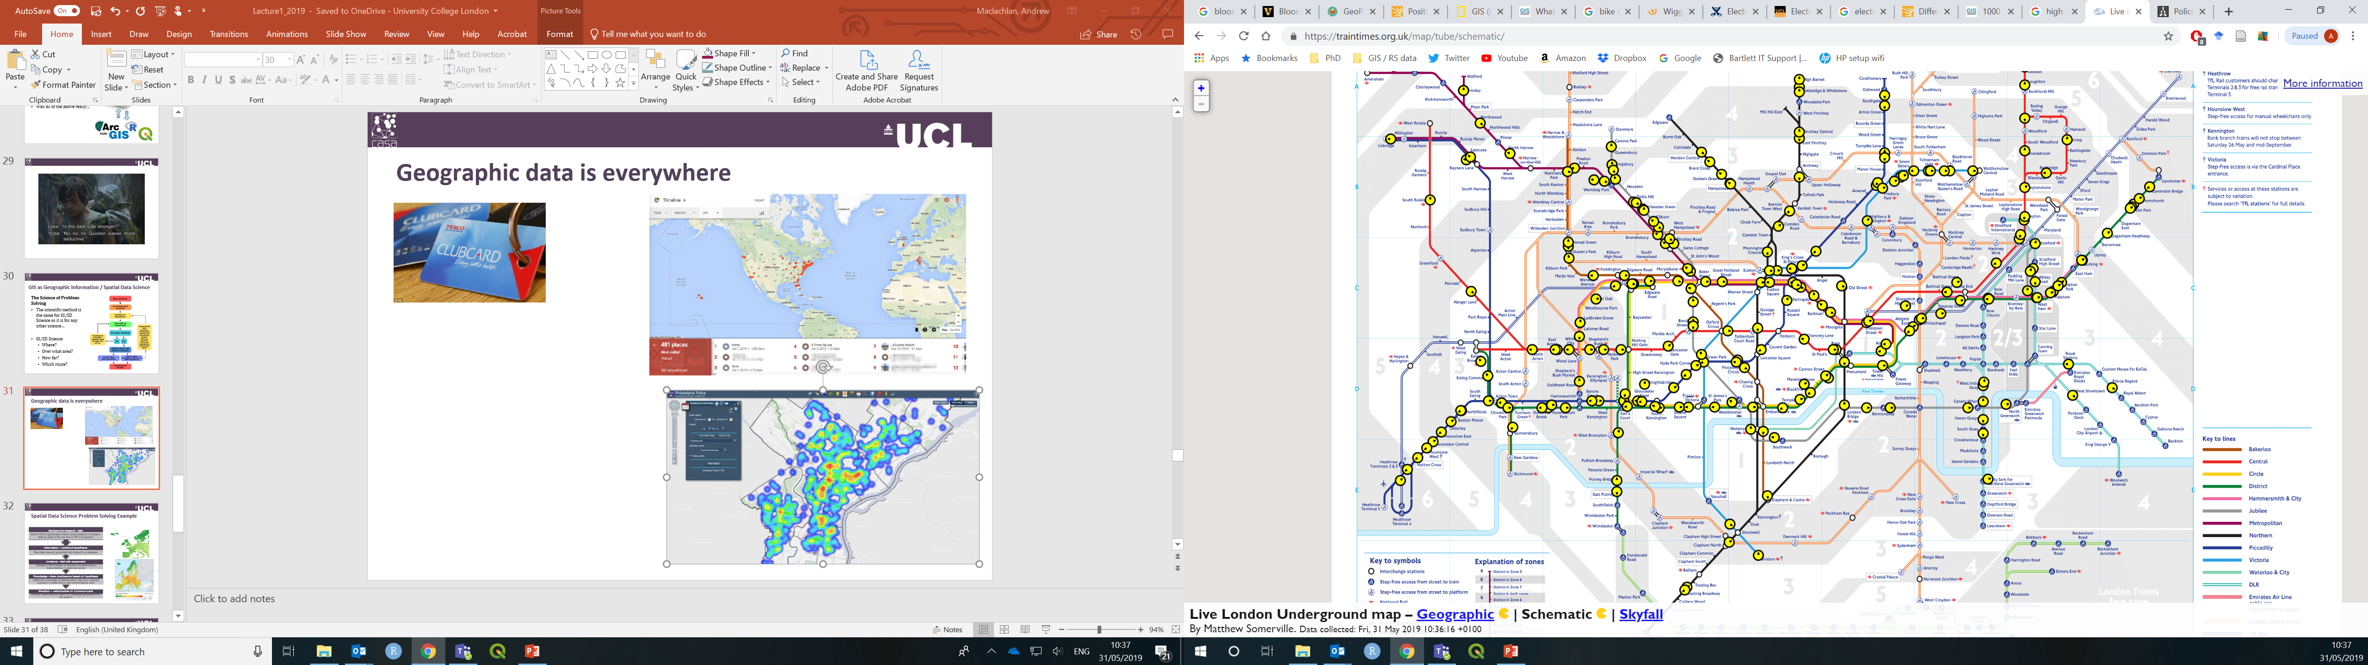
Spatial data is everywhere

Slide 48

Spatial data is everywhere

Slide 49
Types of spatial data: raster (‘grid’) Vs vector
Type | Format | Data type
Raster | Tiff | Continuous
Vector | Shapefile | Float, text, numierc

Slide 50
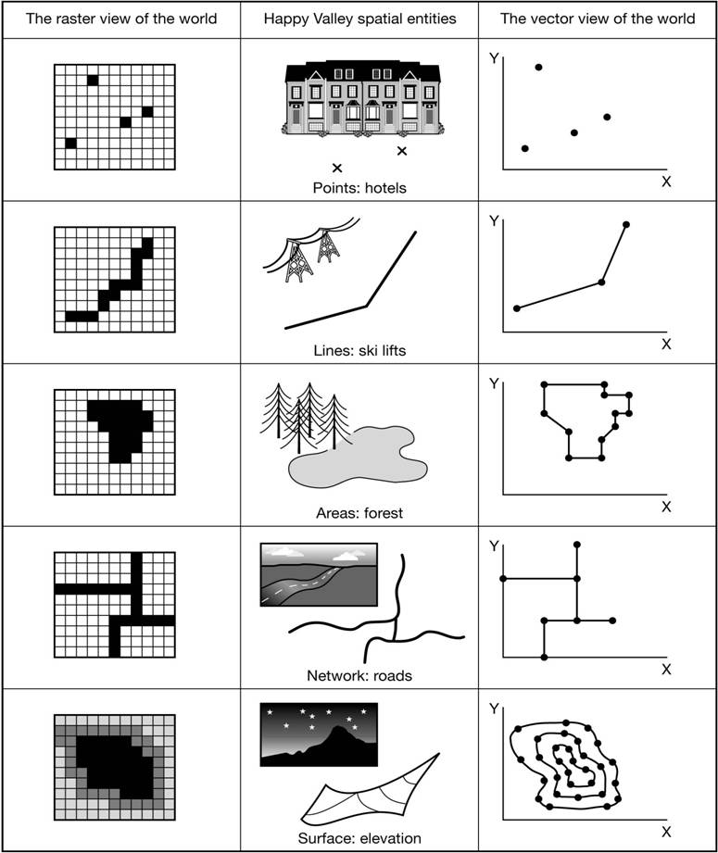
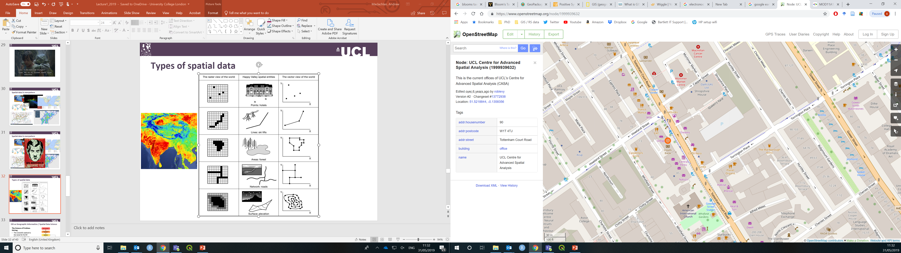
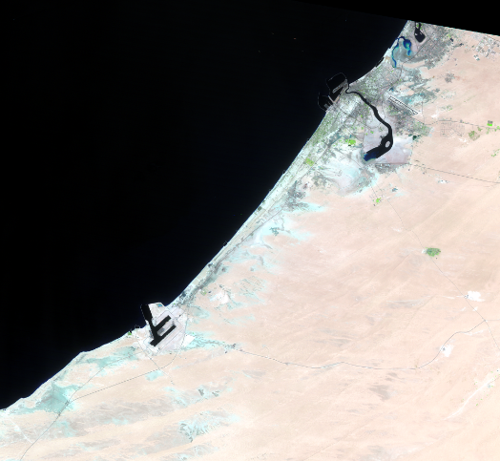
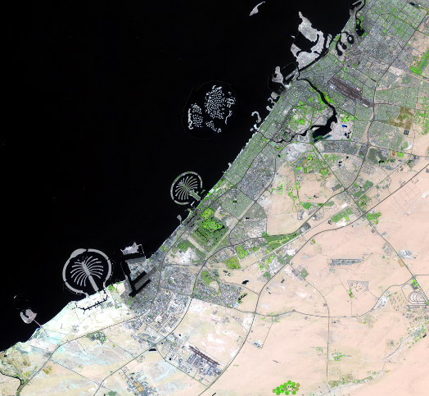
Types of spatial data: raster (‘grid’) Vs vector
Dubai 1984
Dubai 2017

Slide 51
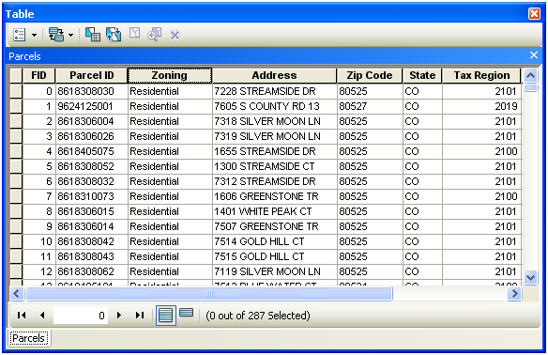
Features – vector data
Each column also has a data type
Text
Numeric?
Data type | Range | Size (mb) | Application
Long integer | -2,147,483,648 to 2,147,483,647 | 4 | Numeric values without fractional values within specific range
Float | -3.4E38 to 1.2E38 | 4 | Numeric values with fractional values within specific range
Text | Alphanumeric symbols | n/a | e.g. street names

Slide 52
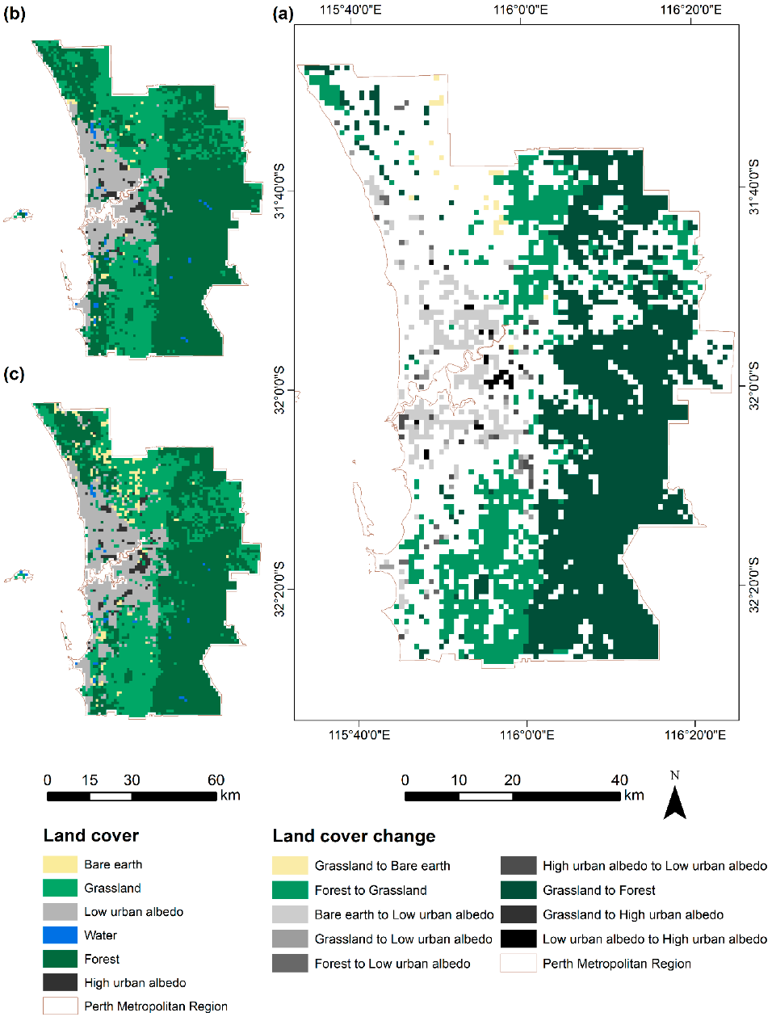
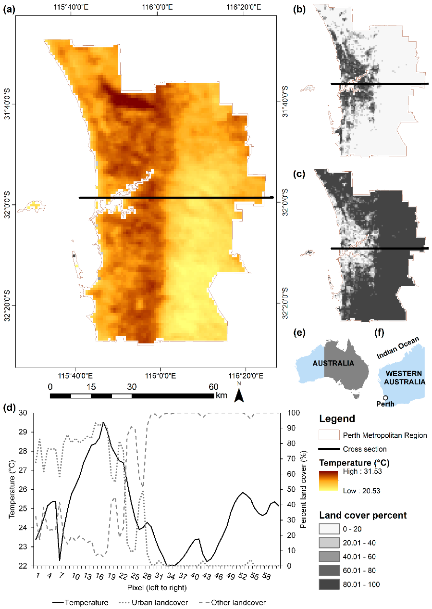
Features – raster data
Categorical (also nominal) (landcover category))
Continuous (temperature)
Notes:
Cell based
Continuous
Discrete
Sometimes raster data can have a scaling factor, or be a bit-encoded manner that refers to a code to extract the information. Read documentation and meta-data.

Slide 53
Formats (file types)
Type | Format | Range
Vector | Shapefile | ESRI’s standard format. Mostly open. Creates multiple files for a single layer. (e.g. .shp, .shx)
 | GeoJSON | Standard open data interchange format. Based on JavaScript Object Notation. Maintained by internet working group.
Both | Geopackage | Database of vector and raster layers held in a single file.
Both | Geodatabase | ESRI’s format for storing multiple raster and vector layers.
Raster | GeoTIFF | Geostationary Earth Orbit Tagged Image File. Standard, public domain format. Geospatial tags in image.
 | BSQ | Band SeQuential – binary. Each band is one file with header file bringing together. Can just read in what you want.
 | HDF | Hierarchical Data Format – NASA. Large scientific datasets.
 | Arc Grid | ESRI’s standard for raster

Slide 54

New formats
Geo feather (or arrow) = short term storage
Geo parquet = long term storage
Build on existing data storage formats but add the spatial element.
The word “GEO” has been added.

Slide 55
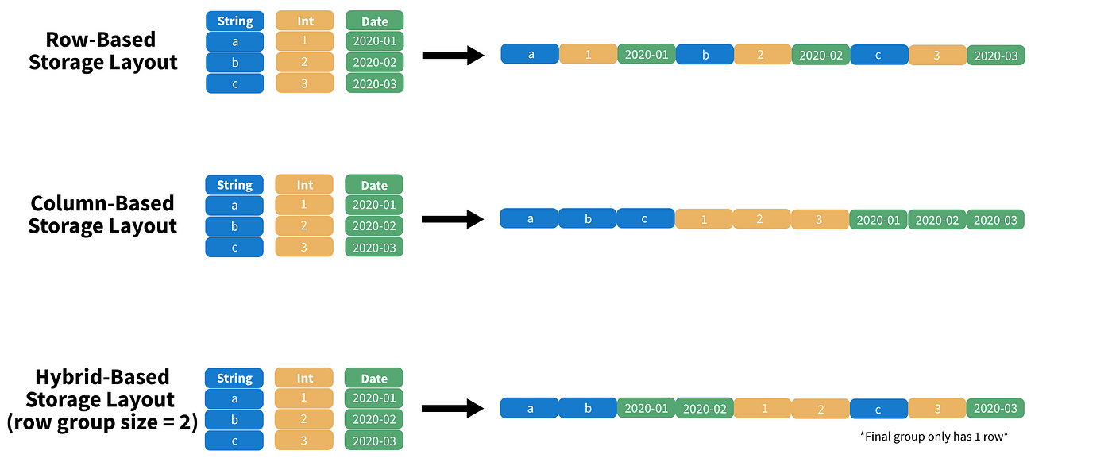
See: https://towardsdatascience.com/demystifying-the-parquet-file-format-13adb0206705

Slide 56
These are great, but do you think Government departments, census website keep up with current trends in spatial data?

Slide 57
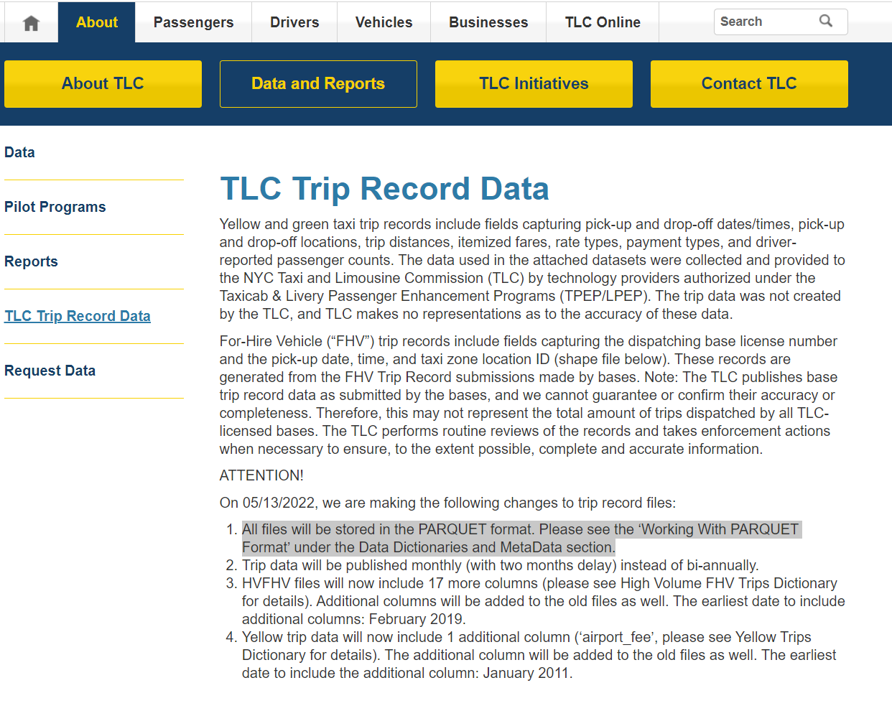
Well actually….

Slide 58
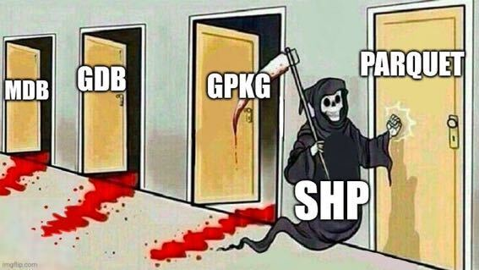
But mostly ….no

Slide 59
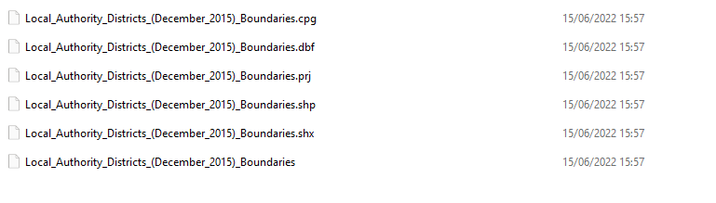
All quite bizarre given shapefiles are not just a single file… you must have all files to open a shapefile
Shapefile(s)?
Files for the shapefile?

Slide 60
What does send me the shapefile mean ?

Slide 61
What does send me the shapefile mean ?
Send me all the files needed to open the shapefile

Slide 62
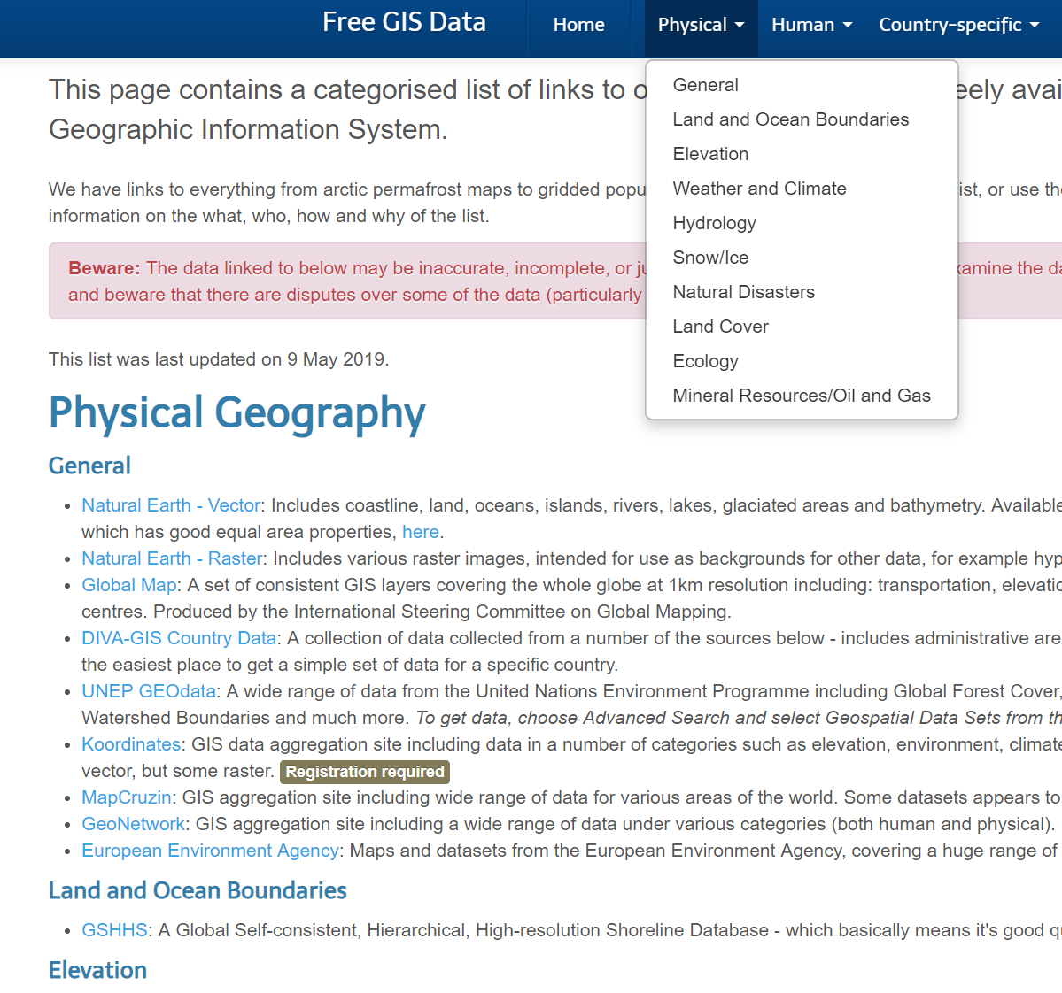
Sources
Raster
USGS Earth Explorer
Environment Agency LiDAR
Geoscience Australia LiDAR
Vector
GADM – global country outlines
Open Street Map
OS Master Map
Both
Free GIS lists (e.g. RT Wilson)
Volunteered Geographic Information (VGI)

Slide 63

Sources
Raster
USGS Earth Explorer
Environment Agency LiDAR
Geoscience Australia LiDAR
Vector
GADM – global country outlines
Open Street Map
OS Master Map
Both
Free GIS lists (e.g. RT Wilson)
Volunteered Geographic Information (VGI)
Always read the metadata.

Slide 64
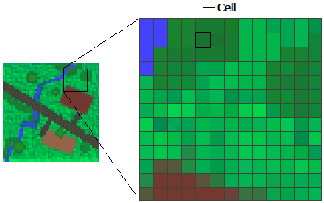
Summary of vector vs raster
Spatial data has a type (vector or raster)
These come in a range of formats (file types – shapefile, geojson)*
The attribute of the spatial data will also have a data type (e.g. text, float, continuous)
* Geopackage can have both vector and raster

Slide 65
Which spatial data type could more easily have multiple attribute types ?
What types could it have?

Slide 66
Which spatial data type could more easily have multiple attribute types ?
What types could it have?
Type: Vector data
Format: Shapefile
Attributes (type of data): Text, Integer, Float

Slide 67
Putting it all together….

Slide 68
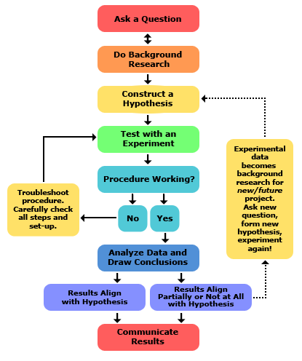
GIS as Geographic Information / Spatial Data Science
The Science of Problem-Solving
The scientific method is the same for GI/SD Science as it is for any other science…->
GI/SD Science…the science of where
Where?
Over what area?
How far?
Which route?
What’s the spatial relationship to each other

Slide 69
The science of where?

Slide 70
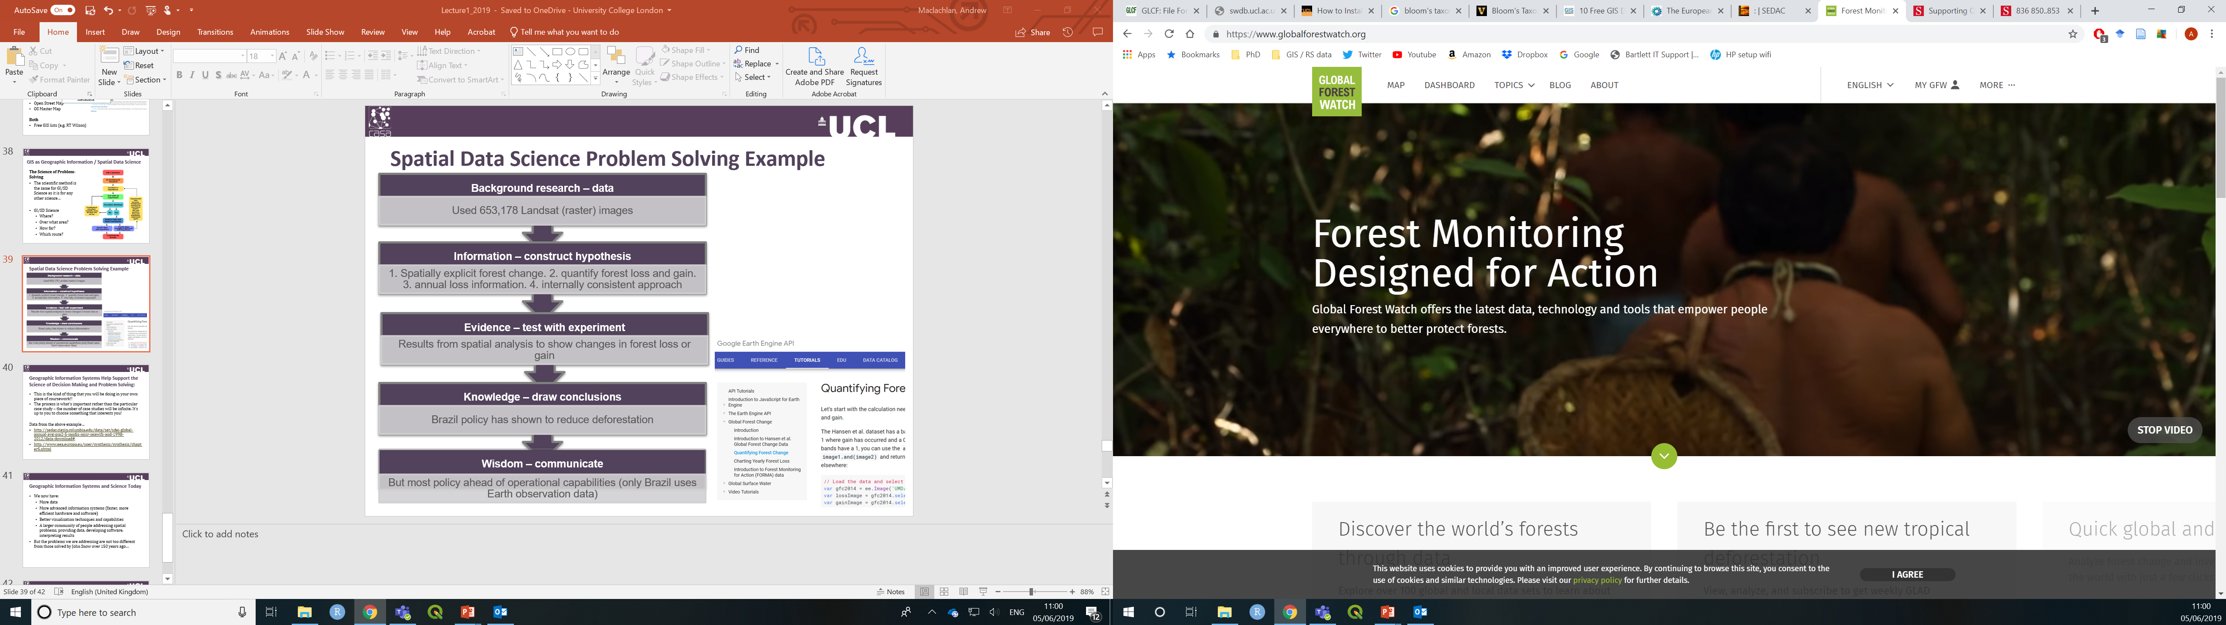
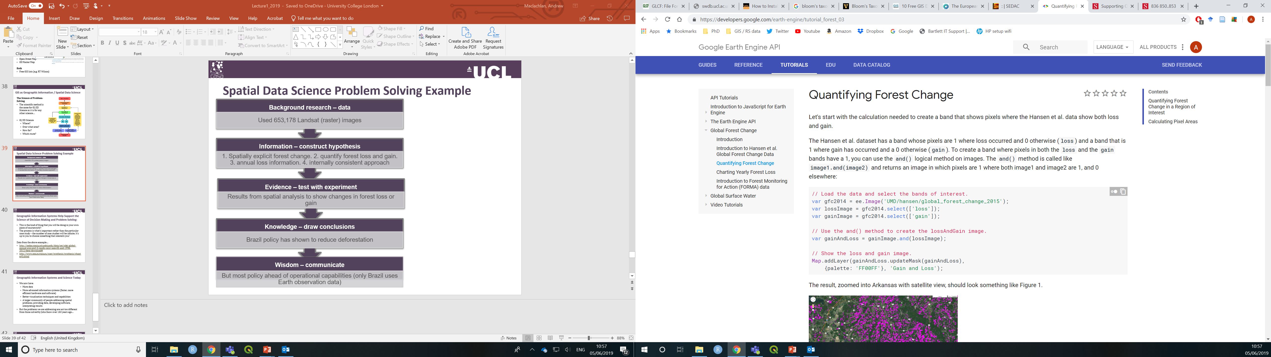
Spatial Data Science Problem Solving Example
Background research – data
Hansen et al. 2013
High-resolution global maps of 21st century forest cover change. Used 653,178 Landsat (raster) images.
Information – construct hypothesis
1. Spatially explicit forest change. 2. quantify forest loss and gain. 3. annual loss information. 4. internally consistent approach.
Evidence – test with experiment
Results from spatial analysis to show changes in forest loss or gain.
Knowledge – draw conclusions
Brazil policy has been shown to reduce deforestation.
Wisdom – communicate
But most policy ahead of operational capabilities (only Brazil uses Earth observation data). Could use this free method or similar.
Notes:
Data and code walk through in Google Earth Engine.
The process is what’s important rather than the particular case study – the number of case studies will be infinite. It’s up to you to choose something that interests you!

Slide 71
Geographic Information Systems and Science Today
We now have:
More data (big data)
More advanced information systems (faster, more efficient hardware and software)
Better visualisation techniques and capabilities
A larger community of people addressing spatial problems, providing data, developing software, interpreting results

Slide 72
Geographic Information Systems and Science Today
Summary
What is spatial data
What types does it come in
Why are they useful
How can we use spatial data and GIS to solve spatial questions

Slide 73
Workshop this week - Geographic Information
Head over to the online practical book – just work from here and follow the instructions. Each chapter = 1 workshop.
Start practical 1
There is rolling weekly feedback at the end of each workshop

Slide 74
Lecture homework
Install software: R, RStudio, QGIS
Start practical 1
Do the homework within practical 1
We will discuss next week.
Review the key ideas and terms:
Geographic / geographical: the Earth's surface and near-surface
Spatial: any space, (not just the space of the Earth's surface)
Spatial Analysis: application of techniques (in GIS) to geographic (Earth’s surface) and non-geographic spaces
Geospatial: subset of spatial applied specifically to the Earth's surface and near-surface

